Slide 1
UN Peacekeeping TOT
Module
1
The Training Cycle

Slide 2
Relevance
Peacekeeping training helps improve mandate implementation
Training facilitators impact the success of training programmes
UN Peacekeeping Training of Trainers
1

Slide 3
Ice Breaker
Five Things in Common
Instructions:
Divide into groups of 4-8 (or table groups)
Come up with five things all members of the group have in common
Share out in plenary
Time: 15 minutes
Table discussion: 10 minutes
Group discussion: 5 minutes
UN Peacekeeping Training of Trainers
2

Slide 4
Learning Activity 1.1
Positive and Negative Training Experiences
Instructions:
Reflect on trainings you have attended in the past. Which experiences were positive and why?
What training experiences were negative? Why?
Write your reflections on post-it notes
Time: 15 minutes
Individual reflection: 5 minutes
Group discussion: 10 minutes
UN Peacekeeping Training of Trainers
3

Slide 5
TOT Learning Objectives
Purpose: To improve the skills of trainers in delivering pre-deployment and other peacekeeping training.
Learners will be able to:
Take into account the needs and experiences of training participants and incorporate this into the design and delivery of training
Facilitate trainings that are interactive in nature, utilizing a mix of learning activities that teach to a broad range of learning styles based on adult learning principles
UN Peacekeeping Training of Trainers
4

Slide 6
TOT Learning Objectives (cont.)
Learners will be able to:
Utilize good practices of teaching and facilitation, including, among other things, delivery skills, interpersonal interaction, debriefing, providing feedback, flexibility and responsiveness to the room, effective communication, effectively engaging all participants and handling challenging audiences
Plan and conduct training evaluations and report on training effectiveness when required
UN Peacekeeping Training of Trainers
5

Slide 7
Final Assessment
TOT participants will be assessed on the following:
Written portfolio
Final performance assessment
UN Peacekeeping Training of Trainers
6

Slide 8
Module 1 Learning Objectives
Learners will be able to:
Define training and the role of a trainer
Identify the phases of the training cycle
Demonstrate an understanding of a TNA and explain its purpose
Conduct a target audience analysis and incorporate this information into training design and delivery
UN Peacekeeping Training of Trainers
7

Slide 9
Learning Overview
What is Training?
What is the Role of a Trainer?
The Training Cycle
Conducting a Target Audience Analysis
UN Peacekeeping Training of Trainers
8

Slide 10
Learning Activity 1.2
Self-Assessment
Instructions:
Work independently to fill out the self-assessment
Come up with 3-5 goals for yourself as a trainer over the course of this TOT
Time: 20 minutes
UN Peacekeeping Training of Trainers
9

Slide 11
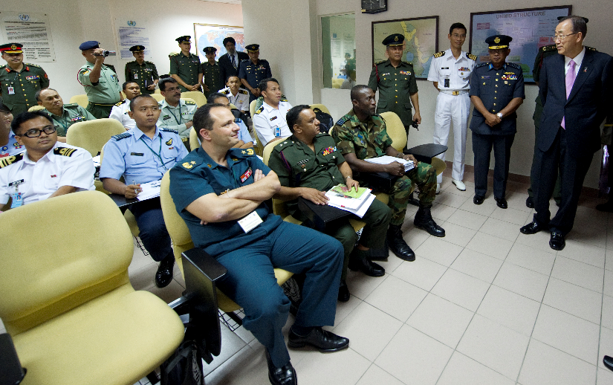
I. What is Training?
Training is a dynamic and transformational process
It can be used to enhance skills, knowledge and/or attitudes
Purpose: to reduce the gap between current and desired competencies
UN Peacekeeping Training of Trainers
10

Slide 12
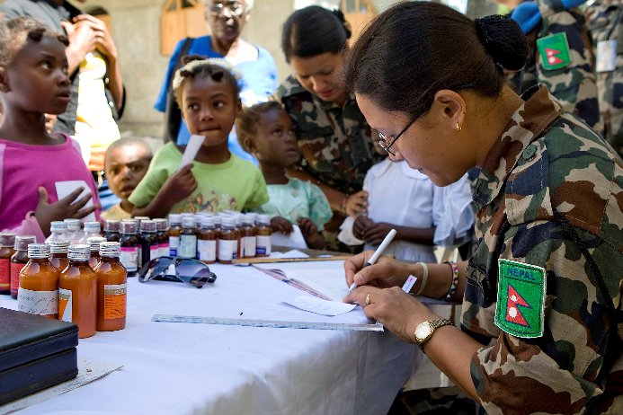
I. What is Training?
The primary purpose of UN peacekeeping training is to enhance mandate implementation
Skills-based
Knowledge-based
Attitudes-based
UN Peacekeeping Training of Trainers
11

Slide 13
I. What is Training?
Training is not a solution for every problem.
It cannot address performance gaps due to:
Lack of clearly defined mandates
Leadership
Guidance
Policies
Resources
Motivation
UN Peacekeeping Training of Trainers
12

Slide 14
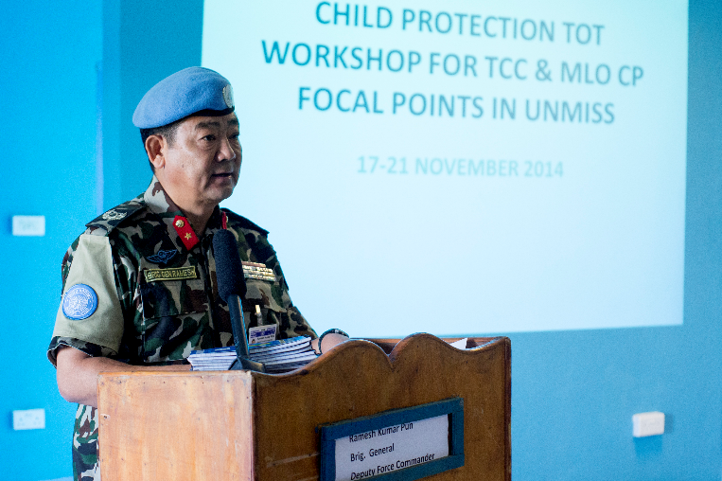
II. What is the Role of a Trainer?
An effective trainer must possess a range of:
Technical
Professional
Interpersonal skills
UN Peacekeeping Training of Trainers
13

Slide 15
Learning Activity 1.3
Identifying the Skills of an Effective Trainer
Instructions:
Working in groups, generate a list of technical, professional and interpersonal skills required to be a trainer
Write your ideas on chart paper
Discuss as a large group
Time: 20 minutes
Small group discussion: 10 minutes
Large group discussion: 10 minutes
UN Peacekeeping Training of Trainers
14

Slide 16
III. The Training Cycle
Step 1: Identify performance gaps
Step 2: Define targets, resources & inputs
Step 3: Design & plan the training
Step 4: Deliver the training
Step 5: Evaluate outcomes
Step 6: Monitor, improve & report results
The training cycle helps programme managers design, deliver and evaluate training activities.
UN Peacekeeping Training of Trainers
15

Slide 17
Step 1: Identify performance gaps
Step 2: Define targets, resources & inputs
Step 3: Design & plan the training
Step 4: Deliver the training
Step 5: Evaluate outcomes
Step 6: Monitor, improve & report results
Step 1: Identifying performance gaps:
What are the gaps in performance?
Is training an appropriate solution?
Training is one part of a broad solution to address performance issues.
UN Peacekeeping Training of Trainers
16

Slide 18
Step 1: Identify performance gaps
Step 2: Define targets, resources & inputs
Step 3: Design & plan the training
Step 4: Deliver the training
Step 5: Evaluate outcomes
Step 6: Monitor, improve & report results
Competency-based TNA:
Compares desired and existing levels of competencies.
What are the knowledge, skills and/or mindsets needed to close this gap?
UN Peacekeeping Training of Trainers
17

Slide 19
TNA Data Sources
Data sources for establishing required competencies | Data sources for analyzing existing competencies
Policies Standard operating procedures (SOPs) Guidelines Mission mandates Work plans Job descriptions | Mission reports Strategic assessment reports Mission performance reviews E-Pas After action reviews End of assignment reports
UN Peacekeeping Training of Trainers
18

Slide 20
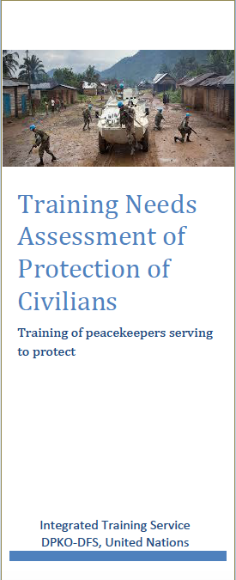
Sample: 2016-2017 TNA on POC
Purpose: identify performance gaps in the implementation of the POC mandate.
Competency-based approach:
What is successful job performance in POC?
What are gaps between current and desired competencies?
Can job performance be strengthened through training?
UN Peacekeeping Training of Trainers
19

Slide 21
Sample: 2016-2017 TNA on POC
Cross-Cutting POC Tasks for all Personnel
Public information: Participate in public information campaigns to promote human rights, assure the population of the mission’s intent to protect, as well as disseminate information on potential risks, POC and human rights reporting mechanisms.
Early warning and alert mechanisms: Develop and use early warning and alert mechanisms to prevent and minimize harm (unlawful and lawful) caused to civilians.
Conflict management and resolution (mediation): Support efforts to mitigate political, economic, identity or community conflicts that may escalate into physical violence.
Dialogue and advocacy: Support dialogue, proactive engagement and advocacy with potential perpetrators of violence, national authorities, and third parties that may positively influence the actions of perpetrators.
Human rights: Promote and protect human rights.
Support and capacity-building of state authorities: Contribute to efforts which support and build the capacity of state authorities.
Humanitarian assistance: Support the efforts to protect and assist IDPs and refugees.
UN Peacekeeping Training of Trainers
20

Slide 22
Sample: 2016-2017 TNA on POC
Translating tasks into competencies:
Competencies for all personnel for cross-cutting POC tasks
Knowledge | Skills
Public information | Communication
Community & civil society engagement | Community and civil society engagement
Use of early warning and alert mechanisms | Threat analysis and risk assessment
Conflict management & resolution | Conflict management
Dialogue & advocacy | Coordination
Promotion & protection of human rights | Capacity-building
Coordination | Safety & security awareness
Support and capacity-building of state authorities | Gender awareness & mainstreaming
Humanitarian assistance | Crisis management
Gender equality & mainstreaming | Human rights monitoring/reporting
UN Peacekeeping Training of Trainers
21

Slide 23
Sample: 2016-2017 TNA on POC
Priority Training Needs for All Personnel (SAMPLE)
Knowledge to develop | Skills to enhance
POC in General: DPKO-DFS POC Operational Concept: scope of POC situations to be addressed and POC activities to be carried out by the mission; distinction between the DPKO-DFS and humanitarian concepts of protection. | Safety and Security Awareness: Awareness of conditions and circumstances that affect one’s own safety of direct reports.
Situational Awareness: POC needs of certain groups in the local/mission context, especially identification of the most vulnerable groups and locations. | Crisis Management: The ability to anticipate, plan for and respond to a variety of potential crises or emergencies.
POC Response: Practical application of the DPKO-DFS POC Operational Concept, POC mandate, strategy, tools, SOFA and ROE/DUF in response to POC situations. | Coordination: The ability to integrate and coordinate POC responses.
UN Peacekeeping Training of Trainers
22

Slide 24
Sample: 2016-2017 TNA on POC
There are limits to what training can achieve.
Attitude and engagement issues also contributed to poor POC performance, e.g.:
Lack of coordination
Unwillingness to engage
Lack of timely response
UN Peacekeeping Training of Trainers
23

Slide 25
Step 1: Identify performance gaps
Step 2: Define targets, resources & inputs
Step 3: Design & plan the training
Step 4: Deliver the training
Step 5: Evaluate outcomes
Step 6: Monitor, improve & report results
Step 2: identifying targets, resources & inputs:
Who needs to learn what?
What will the costs be?
What resources are available?
UN Peacekeeping Training of Trainers
24

Slide 26
Step 1: Identify performance gaps
Step 2: Define targets, resources & inputs
Step 3: Design & plan the training
Step 4: Deliver the training
Step 5: Evaluate outcomes
Step 6: Monitor, improve & report results
Step 3: design and plan the training
Define learning objectives & outcomes
Choose delivery method
Develop content & methodology
Incorporate plans for evaluation
UN Peacekeeping Training of Trainers
25

Slide 27
Step 4: Deliver the training
Adult learning principles should guide delivery.
Step 1: Identify performance gaps
Step 2: Define targets, resources & inputs
Step 3: Design & plan the training
Step 4: Deliver the training
Step 5: Evaluate outcomes
Step 6: Monitor, improve & report results
Adults are/have:
Autonomous & self-directed
Accumulated a foundation of life experiences & knowledge
Goal oriented
Relevancy-oriented
Practical
UN Peacekeeping Training of Trainers
26

Slide 28
Step 1: Identify performance gaps
Step 2: Define targets, resources & inputs
Step 3: Design & plan the training
Step 4: Deliver the training
Step 5: Evaluate outcomes
Step 6: Monitor, improve & report results
Step 5: Evaluate outcomes
Did the programme meet its objectives?
ROI Approach to Evaluation
Level 5
Return on Investment (ROI)
Level 4
Impact
Level 3
Application
Level 2
Learning
Level 1
Reaction
UN Peacekeeping Training of Trainers
27

Slide 29
Step 1: Identify performance gaps
Step 2: Define targets, resources & inputs
Step 3: Design & plan the training
Step 4: Deliver the training
Step 5: Evaluate outcomes
Step 6: Monitor, improve & report results
Step 6: Monitor, improve, report results
Monitoring: ensures there is a link between peacekeeping training and improved mandate implementation.
Reporting: contributes to flow of information so adjustments can be made; all stakeholders aware of successes/ challenges.
UN Peacekeeping Training of Trainers
28

Slide 30
IV. Target Audience Analysis
Purpose: allows facilitator to customize the training to needs and experiences of the participants.
Gathering information:
Participants list
Questionnaires, surveys
Speak with supervisors, commanders, other stakeholders
UN Peacekeeping Training of Trainers
29

Slide 31
Learning Activity 1.4
Conduct a Target Audience Analysis
Instructions:
Review the mock list. What do you observe?
How will this impact the way you design/deliver the training?
What other information might be helpful?
How could you gather this information? What sorts of tools might you use?
Time: 25 minutes
Individual work: 15 minutes
Small group discussion: 10 minutes
Additional work to be completed as homework
UN Peacekeeping Training of Trainers
30

Slide 32
Summary
Training is a dynamic process that can be used to influence skills, knowledge and/or attitudes
The purpose of peacekeeping training is to enhance mandate implementation
A trainer must possess a range of professional and interpersonal skills
The training cycle helps programme managers design, deliver and evaluate training activities
Conducting a target audience analysis allows the facilitator to customize the training to the needs and experiences of the participants
UN Peacekeeping Training of Trainers

